Slide 1
Business analytics
Session 6

Slide 2
Week 6
Artificial Intelligence
Prescriptive Analytics
Predictive Analytics
Optimization (II, III)
Risk modeling (IV, V)
Value
Diagnostic Analytics
Forecasting (I)
Simulation (V, VI)
Descriptive Analytics
Extract, Transform, Load
Difficulty
Notes:
Simulation is more versatile and can be used for both predictive and prescriptive

Slide 3
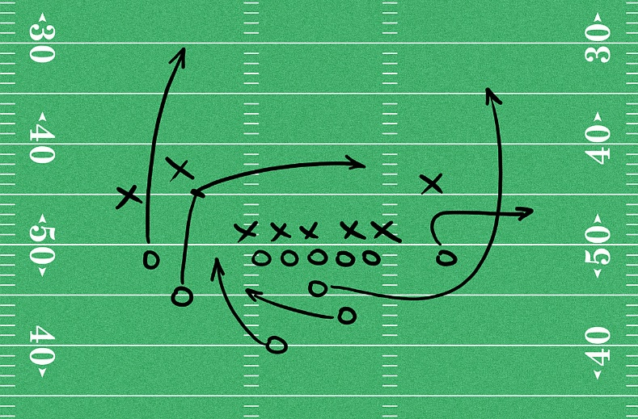
Game plan
SIMULATION: Brief history and Applications
Simulation in Python
SIMULATION PRACTICE PROBLEMS
The “ART” of Business analytics

Slide 4
Game plan
SIMULATION: Brief history and Applications
Simulation in Python
SIMULATION PRACTICE PROBLEMS
The “ART” of Business analytics

Slide 5
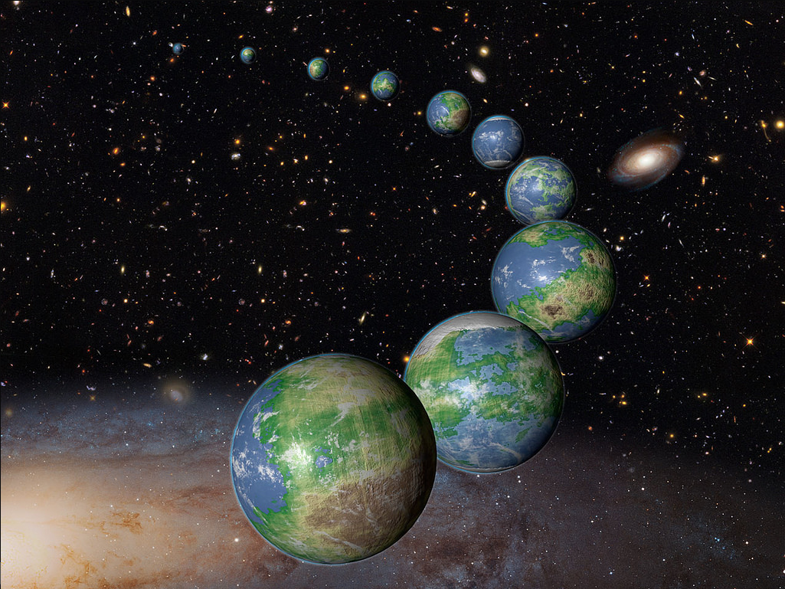
What is Simulation?
Definition: Simulation is the process of studying the behavior of a real system by using a computer-based model that replicates the behavior of that system.

Slide 6
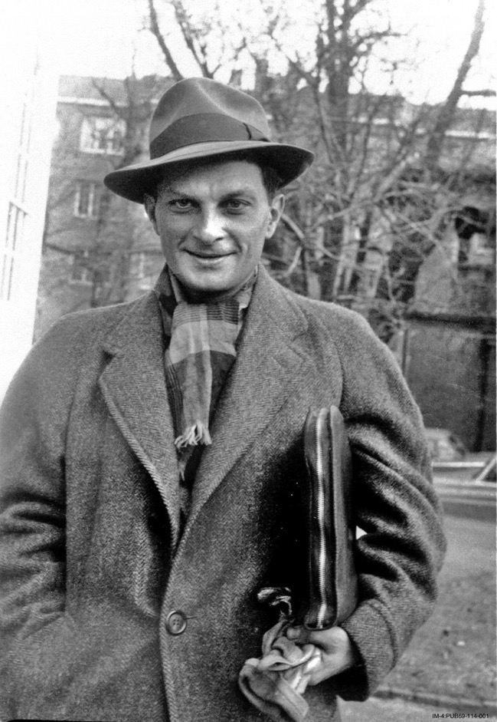
Stanislaw Ulam (1909-1984)
key contributor to Manhattan Project
inventor of Monte-Carlo simulation
“To calculate the probability of a successful outcome of a game of solitaire is a completely intractable task.
The practical procedure is to produce a large number of examples of any given game and then to examine the relative proportion of successes.”
S. Ulam

Slide 7


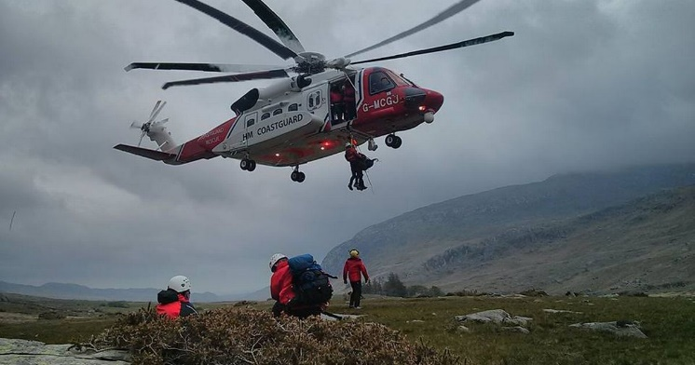

Applications of Simulation
Physical Sciences
Engineering
Climate Change
Computational Biology
Computer Graphics
Applied Statistics
AI for Games
Design and Visuals
Search and Rescue
Finance and Business
Law

Slide 8

Pros & Cons
Flexibility
Can handle large and complex systems
Can handle “what-if” questions
Does not generate optimal solutions
Subjective: managers must choose “what-if” scenarios
Each model is unique

Slide 9

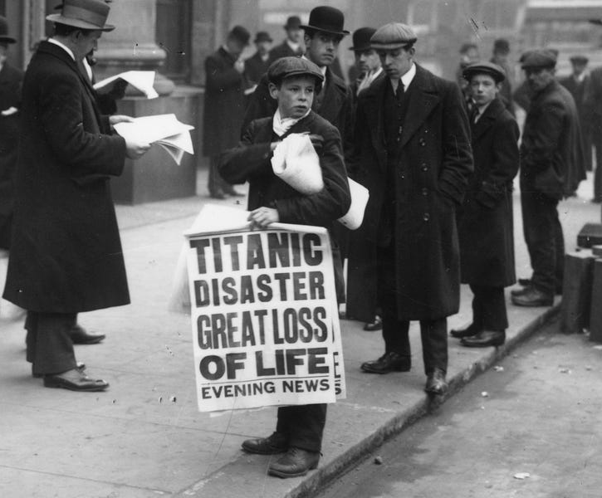
Last Week: Newsvendor/Newsboy Problem
Given uncertain demand, how much should I order?

Slide 10

Overbooking in Airline Revenue Management
Given uncertain no-shows, how much should I overbook?

Slide 11
Overbooking example
PROBLEM:
a) Suppose you are UNITED. Flight is sold out, but you can also overbook since some people may not show up.
The revenue from each ticket is $500 (all costs are sunk)
Historical data: number of no-shows is either 1, 2 or 3, with probabilities 30%, 40% and 30%, respectively.
When a customer is denied boarding due to overbooking, you must reimburse their ticket (i.e. pay back $500) and additionally issue them a $250 voucher.
How much do you overbook?

Slide 12
Overbooking example
PROBLEM:
b) Your past data reveal that no-shows for this flight range from 0 to 10, with each number being equally likely (I.e. a discrete uniform probability distribution on {0,1,2,3,4,5,6,7,8,9,10}).
How much do you overbook?
Note: we can solve this problem using decision trees/expected value analysis instead of simulation, but it will take more time and effort.

Slide 13
Overbooking example
PROBLEM:
c) Your past data reveal that no-shows for this flight range from 1 to 3, with the following distribution:
How much do you overbook?
X = No-shows | 1 | 2 | 3
Prob. (X) | 0.2 | 0.5 | 0.3
Cum prob. F(X) | 0.2 | 0.7 | 1.0

Slide 14
Overbooking example
d) Assume now that each bumped customer tries to negotiate a high voucher value, with the highest voucher value capped at $500. Specifically, assume that the voucher value is distributed uniformly between $0 and $500 (continuous uniform distribution). How much should you overbook? You can assume the no-show distribution from part c).

Slide 15
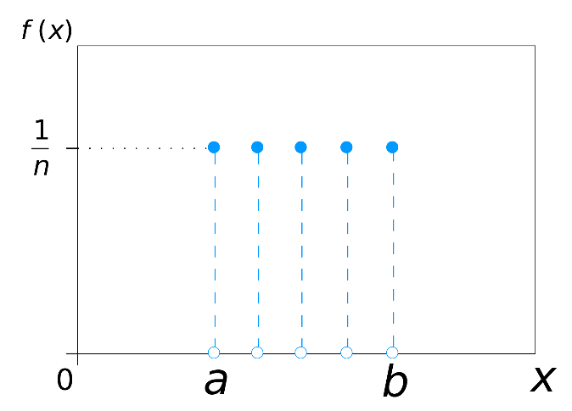
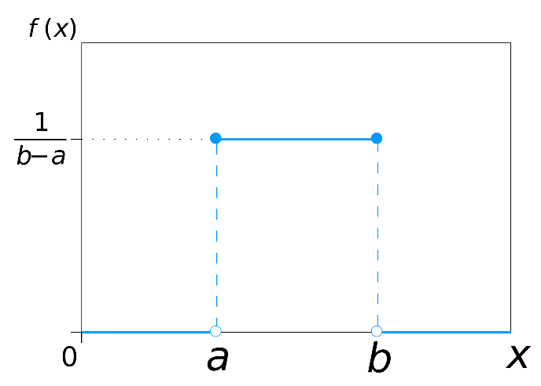
Random variables
So far:
X | 300 | 400 | 500
Prob. (X) | 0.2 | 0.5 | 0.3
Cum prob. F(X) | 0.2 | 0.7 | 1.0
Discrete uniform: RANDBETWEEN (a,b)
Continuous uniform: RAND()
Generating from past data

Slide 16
When things are more complicated…

Slide 17
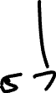
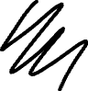
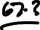
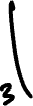
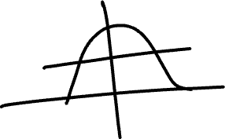
Generating Random Variables in Excel
We can use EXCEL to generate both Normal and Gamma random numbers:
NORMINV(RAND(),5,1.5)
GAMMA.INV(RAND(),1,2)
Both Normal and Gamma are unbounded and continuous distributions. To get discrete values between 0 and 10
Need to ”trim” (“truncate”) at bounds
Need to round
Notes:
Normal distribution graph: https://homepage.divms.uiowa.edu/~mbognar/applets/normal.html
Gamma distribution graph: https://homepage.divms.uiowa.edu/~mbognar/applets/gamma.html

Slide 18

Group Work (10-15 minutes)

Slide 19
Overbooking example (continued)
Suppose you know from past data that the no-shows are most likely to be 5, and in 70% of the cases are between 3 and 7.
- Use a continuous distribution (e.g. Normal), trim and round
Suppose you know from past data that the no shows are most likely to be 0, 1, 2. Values > 3 are rare but possible.
- Use a distribution with positive support values (e.g. Gamma 1,2), trim and round

Slide 20
Game plan
SIMULATION: Brief history and Applications
Simulation in Python
SIMULATION PRACTICE PROBLEMS
The “ART” of Business analytics

Slide 21
Link to Python
https://colab.research.google.com/drive/1oHlKNAnOIlSB_HPs0mBFvYqgtWuk6y9S?usp=sharing

Slide 22


Slide 23
Game plan
SIMULATION: Brief history and Applications
Simulation in Python
SIMULATION PRACTICE PROBLEMS
The “ART” of Business analytics

Slide 24
Monte Carlo Simulation in the Media
https://www.dropbox.com/scl/fi/f7ipxkh4lva0j63pwwnkv/Untitled.mov?rlkey=lcwpv0123er7f90zh7s99drl8&st=n8xy3x8v&dl=0

Slide 25
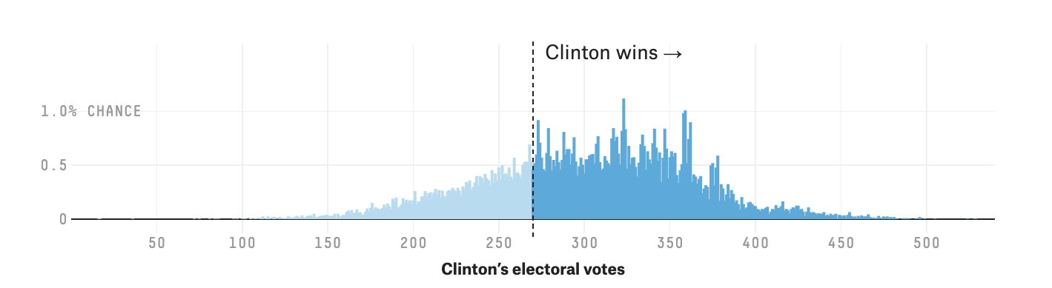
Flaw of the averages: interpreting simulation output
2016 presidential election forecast: Clinton’s electoral votes
Actual = 227
Average = 306
Based on 40,000 simulations, using aggregate polling data Source: 538, 11/2016

Slide 26
Flaw of the averages: interpreting simulation output
2020 presidential election forecast: Biden’s electoral votes
Actual = 306
Average = 370
Based on 40,000 simulations, using aggregate polling data Source: 538, 11/2020

Slide 27
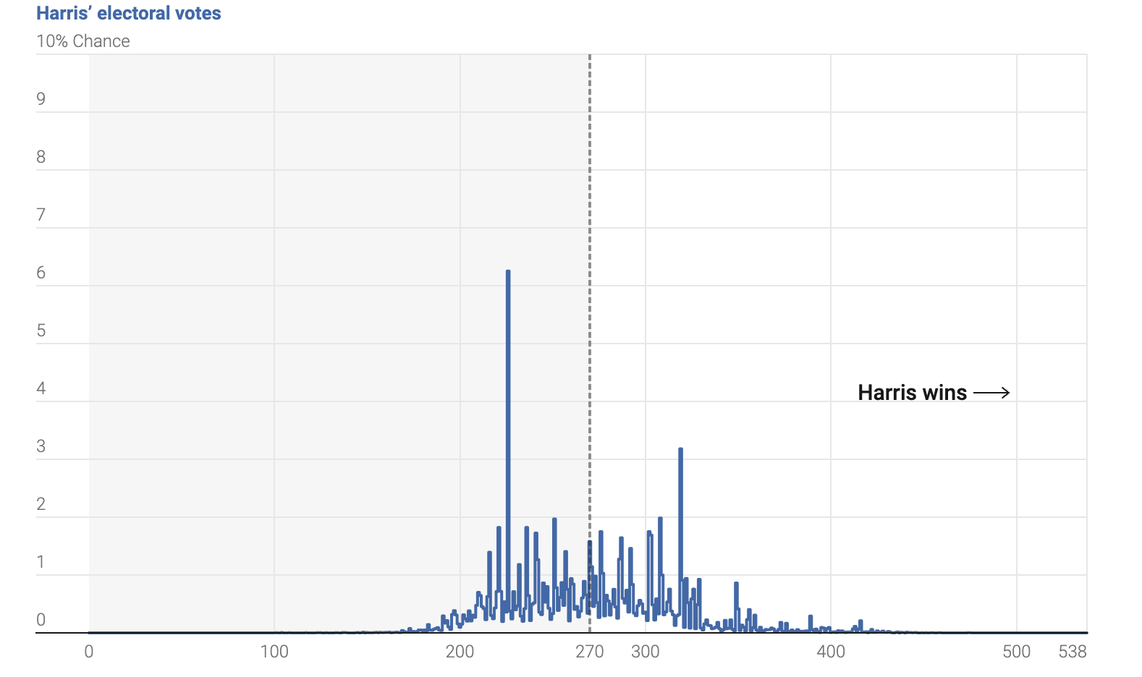
2024 Election: Simulations
Actual = 226
Average = 270
Based on 80,000 simulations, using aggregate polling data Source: Nate Silver

Slide 28
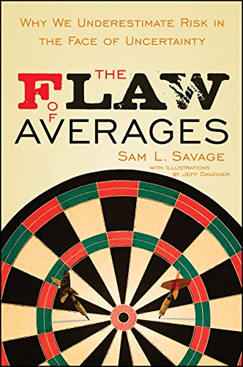
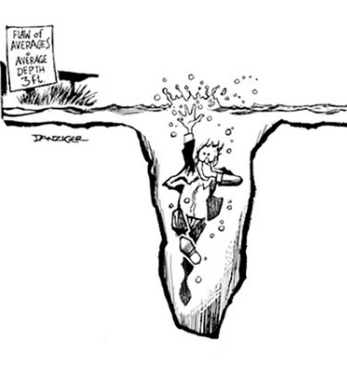
On the usefulness of risk modeling & simulation

Slide 29
Example from last week
Average demand = 200 → Should I stock 200? No!
Profit:
Demand = 100
100*100-100*25=7.5K
Demand = 200
100*100-100*25=7.5K
Order 100
Demand = 300
100*100-100*25=7.5K
Demand = 100
100*100-200*25=5K
How much to order?
Order 200?
Demand = 200
200*100-200*25=15K
Demand = 300
200*100-200*25=15K
Order 300
Demand = 100
100*100-300*25=2.5K
Demand = 200
200*100-300*25=12.5K
Demand = 300
300*100-300*25=22.5K

Slide 30
Example from last week
Profit:
Demand = 100
100*100-100*25=7.5K
How much to order? Answer: to maximize expected profit, order 300 cases
Demand = 200
100*100-100*25=7.5K
Order 100
Demand = 300
100*100-100*25=7.5K
Demand = 100
100*100-200*25=5K
Order 200
Demand = 200
200*100-200*25=15K
Demand = 300
200*100-200*25=15K
Order 300
Demand = 100
100*100-300*25=2.5K
Demand = 200
200*100-300*25=12.5K
Demand = 300
300*100-300*25=22.5K

Slide 31
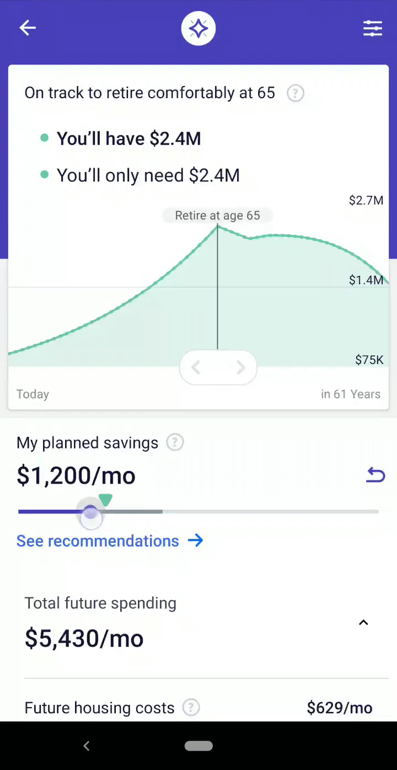
Simulation in Finance
Modern portfolio management models rely heavily on Monte-Carlo Simulation

Slide 32
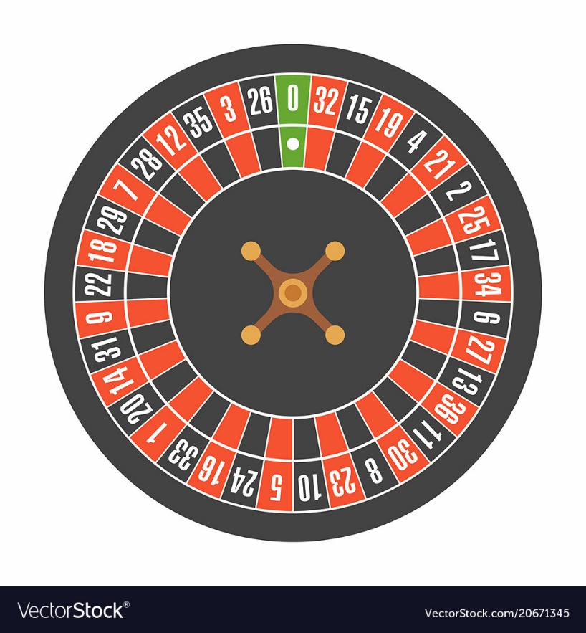
GAP recap
Define model in words
O: Objective
D: Decision variables
R: What is the source of randomness?
Formulate model mathematically
D: Define decision variables
R: Define random variables
O: Define objective function in terms of decision variables & random variables
Solve using Excel
Generate MANY (>1000) random draws
For each random draw calculate objective function value
Take the average of objective function values

Slide 33
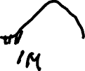
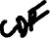
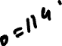
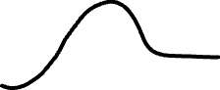
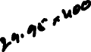
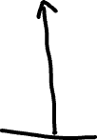
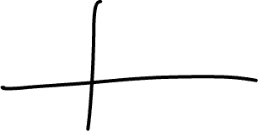
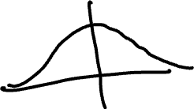
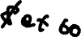
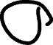
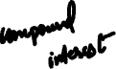
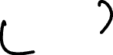
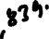

Slide 34
Predictive vs Prescriptive
What will happen next?
What is the optimal decision?
Predictive Analytics
Prescriptive Analytics
Note:
In predictive analytics we sometimes don’t have an objective function or decision variables.
Simulation

Slide 35
GROUP WORK (~30 minutes)

Slide 36

BREAKOUT ROOMS (30 minutes)
If helpful formulate GAP Note: some GAP fields might be empty in some problems
Retirement Planning

Slide 37
Part (a)
You are 30 years old and want to make annual contribution of $4000 from now till you reach 60.
Assume interest is normally distributed with mean = 12% and std. dev. = 2%; interest is added annually and reinvested.
What is the probability of reaching the target ($1 Million) at the age 60?

Slide 38
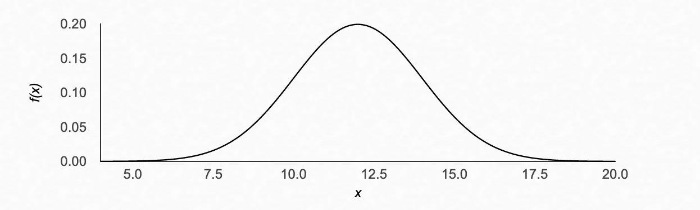
Normal distribution (mean = 12, sigma = 2)

Slide 39
Part (b)
Perform sensitivity analysis (change $4000 to different values, e.g. $3000, $3500). What is the lowest annual contribution to reach your target of $1M with at least 95% probability?

Slide 40
Part (c)
You are 30 years old and want to make annual contribution of $4000 from now till you reach 60.
You want to estimate probability of reaching the target ($1 million) at the age 60 and conduct sensitivity analysis.
Interest rate estimation
Year 1: 10%
Years 2,… : same as previous year or ± x %, where x is uniform between [0, 5%]
Guaranteed minimum: 3%

Slide 41
Retirement Planning GAP
Define model in words
O: Objective
D: Decision variables
R: What is the source of randomness (risk)?
Formulate model mathematically
D: Define decision variables
R: Define random variables
O: Define objective function in terms of decision variables and random variables
a) none, b) Make sure you have 1M by age 60
a) None b) How much to save each year
Interest rate each year
b) X = amount to invest each year
R1 Normal (0.12,0.02), R2 Normal (0.12, 0.02), etc.
Prob. (Y_final) > 1M needs to be greater than 95%, where
Y_final = (X * (1+R1) +X)*(1+R2) + X) * (1+R3)*… *(1+R30)

Slide 42
Game plan
SIMULATION: Brief history and Applications
Simulation in Python
SIMULATION PRACTICE PROBLEMS
The “ART” of Business analytics

Slide 43
Business Analytics
Data
Analytics (Modeling)
Story/
Visualization

Slide 44
Business Analytics: The ”Science”
Data
Analytics (Modeling)
Story/
Visualization
This class! (Mostly)

Slide 45
Business Analytics: The “Art” + “Science”
Data
Analytics (Modeling)
Story/
Visualization
Group projects;
Real life

Slide 46
Business Analytics
Data
Analytics (Modeling)
Story/
Visualization
Qualitative (interview)
Quantitative (great to have but not required)

Slide 47

Choosing the right model
Is there a clear trade-off? E.g.:
Overstaffing/understaffing a restaurant
Fixed costs of opening a new location, offset by increased sales
If no clear trade-off, probably need predictive model
Is managing risks key to success in this industry?
If no, use optimization
If yes, use decision trees/simulation

Slide 48
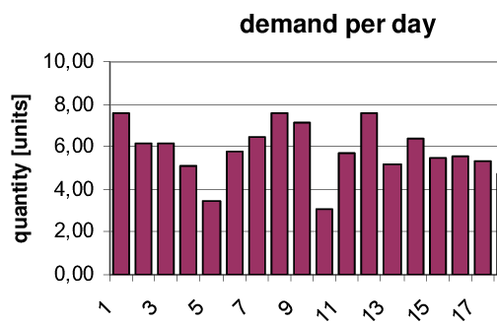
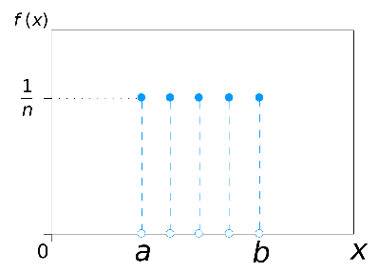
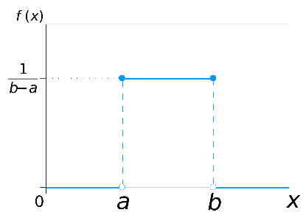
How to model risk?
Simulate random draws directly from past data
Yes
Do you have access to past data?
Use uniform distribution
No
Do you know any- thing about the random process?
No
Choose appropriate probability distribution based on:
Are values/outcomes discrete or continuous?
Can values be negative?
Yes

Slide 49
Business Analytics
Data
Analytics (Modeling)
Story/
Visualization

Slide 50
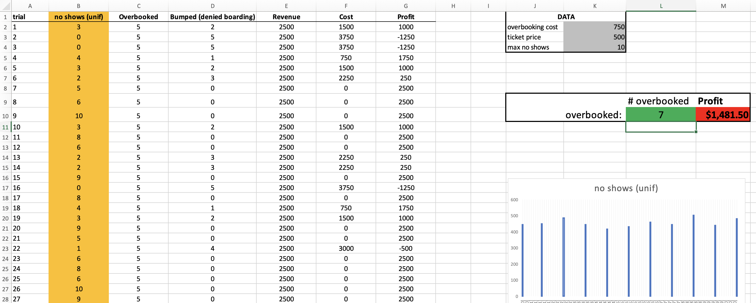
Visualization: Not like this

Slide 51
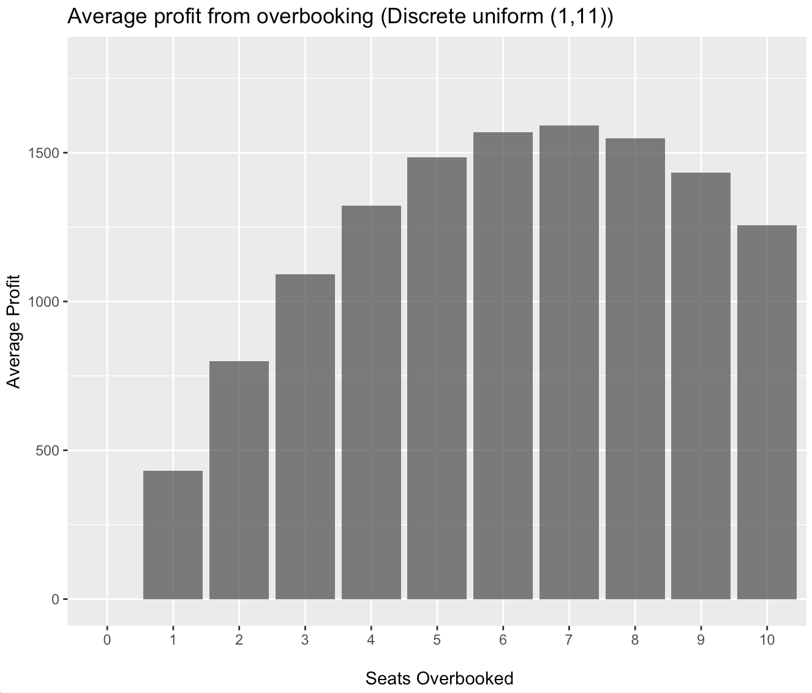
Visualization
Overbooking 7 seats is the profit-maximizing decision alternative

Slide 52

Next week
PROJECT DELIVERABLE:
Presentation:
10 minutes
Not all members have to present
Be clear, concise and have actionable recommendations.

Slide 53
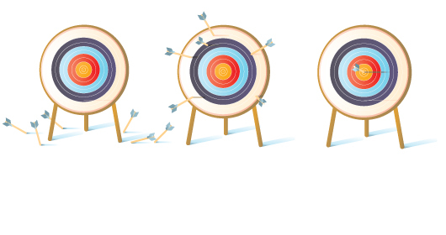
Resources for practicing on BB
Practice problems (Optimization, Risk, Simulation) with solutions
Exam practice problems with solutions
My office hours

Slide 54
Next week
~ 90 minutes presentations
~ 75 minutes class wrap-up & exam review

